Slide 1


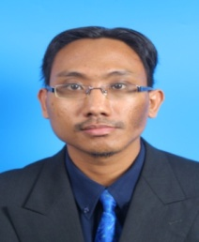

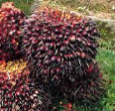
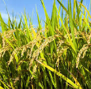
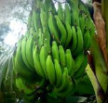
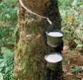
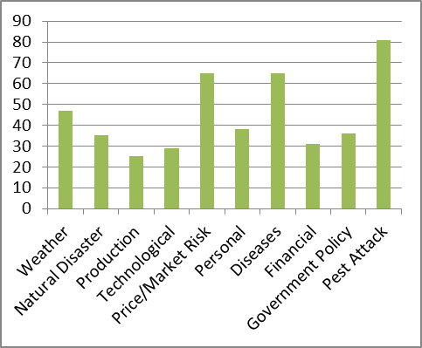
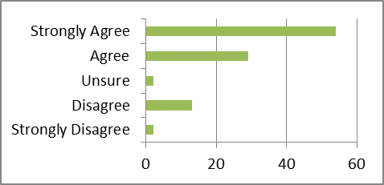
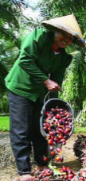
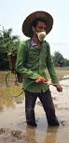
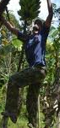
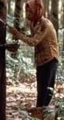
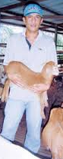
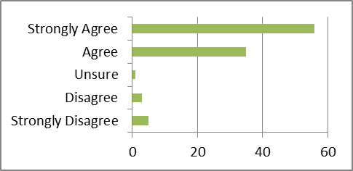
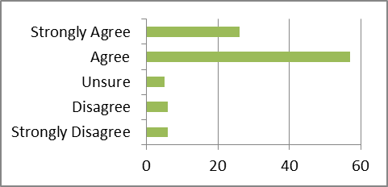

Identifying Risks of Financing for Agro Projects in Islamic Banks
Dr Muhammad Ridhwan Ab. Aziz,
Senior Lecturer,
Universiti Sains Islam Malaysia
xyz@
usim.edu.my
Muhammad Mohd Yusoff,
Research Asisstant
Universiti Sains Islam Malaysia,
abc@gmail.com
Findings
Risks Involved by Agro-Entrepreneurs:
Risk and uncertainty are inherent in agro projects and commodity supply chains. Given the pervasiveness of risks, farmers, agro-entrepreneurs, international agencies, and banking institutions are increasingly seeking effective and sustainable strategies and approaches to mitigate, transfer, or cope with these inherent risks.
What are the risks associated with agro projects for financing in Islamic Banks?
To examine the type of risks and uncertainty associated with agro projects for financing in Islamic Banks.
Methods
Abstract
QUESTIONNAIRES:
- 27 Close-ended questions
Risk threats concern:
Palm Oil Paddy Banana Rubber Others
Research Question
Decision to continue project upon risks:
Objective
100 Muslim Agro-Entrepreneurs
Sg. Sumun, Perak & Sg. Besar, Selangor
Table 1:
Reliability Tests of Questionnaires
Finding solution of encountering risks:
No | Item | σ
Cronbach Alpha = 0.764
8 | Aforementioned risks had threatened my agro projects | 1.110
9 | I will continue my agro project even though I had to encounter with the aforementioned risks | 1.017
10 | I will find solutions to encounter the aforementioned risks | 1.045
Most agro-entrepreneurs are willing to precede their agro projects regardless of any risks they need to go through because of the following reasons:
Their agro projects are main source of daily income.
Conclusion
They want to reserve the land which was inherited from their ancestors for future generations.
There are several risks which have been encountered by agro-entrepreneurs in agriculture projects and require them to finance their projects using Shariah-compliant financing and banking products.
Majority of respondents are willing to continue their agro projects even though they encounter various risks, and had some knowledge or experience about the advantage and disadvantages of those risks.
Local Islamic banking institutions should take these risks into consideration in providing monetary funds to the agro-entrepreneurs
High market demand of agricultural products.
Acknowledgement
This research is benefited from the funding of the University Research Grant of Universiti Sains Islam Malaysia (USIM), (Developing a Financing Model for Agro Projects Complied with Shariah Requirement for the Banking Institutions)(USIM: PPP/FEM/IWM/30/13712).

